Slide 1



Slide 2

Student Activity Monitoring In Online Learning Environment
Supervised by:
Dr Muhammad Shahzad Faisal
Co-supervised by
Mr Najam Dar
Group Members:
Saad Bin Aziz( FA17-BCS-068 )
Jahanzeb( FA17-BCS-050 )
Presented on
(Cs Department) COMSATS University Islamabad
Attock Campus

Slide 3
Outline
Introduction
Problem statement
Objectives
Methodology
Functional requirements
Existing apps
Tools and technology
Benefits
Diagrams
System screenshots
References

Slide 4
Introduction
In hybrid courses of universities, students daily watch video lectures. Making of video lectures requires a lot of time as well as hard work of teachers. Hybrid courses allow students additional exposure to course content that is not possible in a traditional classroom environment.
Our Application will monetarize students activity That how much did they watched the lecture
After the monetarizing of students app will generate summary which is visible by teacher

Slide 5
Problem Statement
In online learning environment the main problem arises it the students don’t watch the video lectures and just give their exams through cheating .
This just wastes the hard work of the teacher who had made recorded lectures for them in the whole course and the thing is when the student is being bound on watching the lectures the lecture then he will definitely learn from that lecture .
They will not do the cheating in the exam and teachers will not go blindly that students had watched the lecture .

Slide 6
Objectives
The main aims and objectives of our system are as under :-
Student will focus on lecture.
This app is to provide an integrated communication platform where they will satisfy the teacher and student .
Summarize the student’s history of watched lecture
Student gives the feedback to the teacher
Teacher can modify his lecture according to the feedback
Teacher can mark attendance of students according to summary generated by our app

Slide 7
Methodology
Admin (Teacher) can upload and delete lecture and can see the feedback given by the students and can see the summary
Students can give feedback
Application user will be monetarized

Slide 8
Functional requirements
Login
User registration
Logout
Monetarizing through camera
Feedback
Summary
Search Student

Slide 9
Functional requirements
Delete TO
Update TO

Slide 10
Existing apps
Features | Online Student Attendance System in PHP Mysql | Online attendance management system. | Smart attendance management system using face recognition | Real-Time Smart Attendance System using Face Recognition Techniques
Monetarizing Of Student | Yes | Yes | Yes | Yes
Feedback | No | No | No | No
Continuous Monetarizing | No | No | No | No
EyeBall detection | No | No | No | No
Lecture Upload | No | No | No | No

Slide 11
Tools and Technologies
Tools & Technologies | Rationale
Python | Programming language
MS word | Documentation work
MS PowerPoint | Presentation work
MS Visio | Diagram work
Pycharm & VScode | Programing tool
Firebase Real Time Database | Backend work

Slide 12
Benefits
Student will definitely learn from lecture
Teacher’s hard work will not be wasted
Students can send feedback to teachers
Teachers can see the summary of students that how much he had watched the lecture.
Teacher will get help from the feedback.

Slide 13
Diagrams
Use Case Diagrams
Teacher Use Case Diagram
Student Use Case Diagram
Activity Diagrams
Teacher Activity Diagram
Student Activity Diagram
Class Diagram
ERD

Slide 14
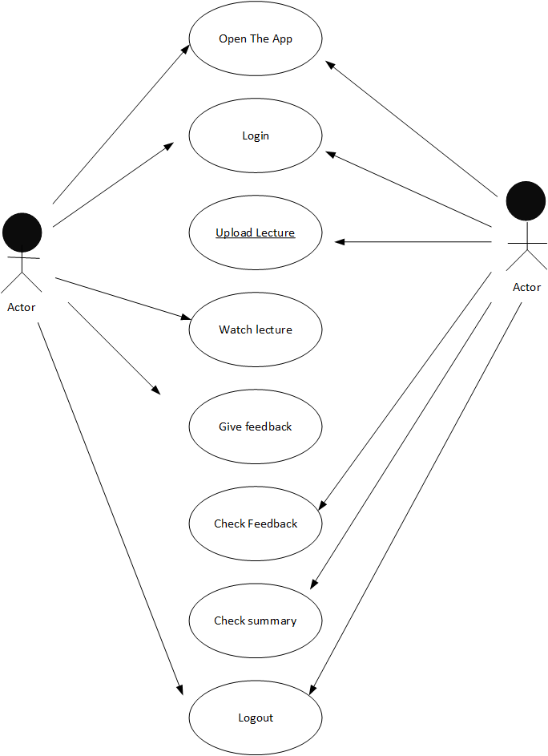
Teacher and Stuent Use case Diagram

Slide 15
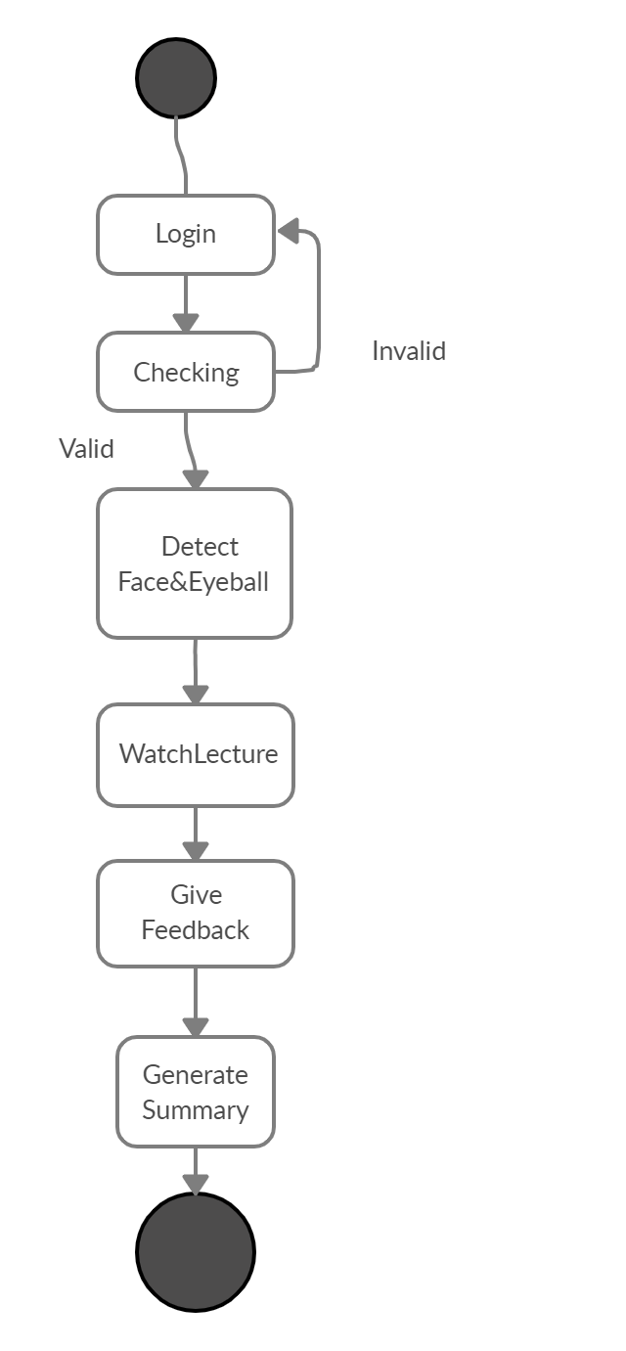
Teacher & Student Activity Diagram

Slide 16
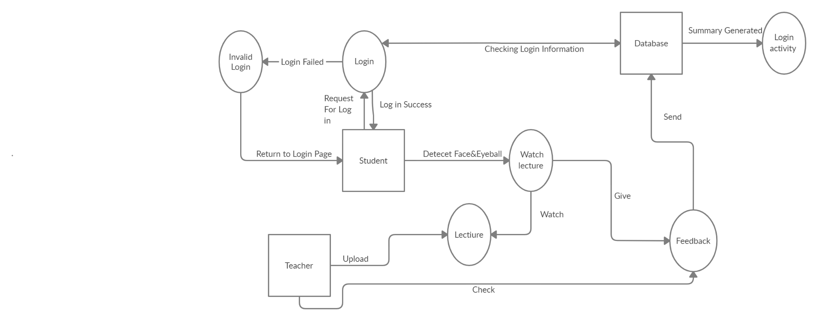
ER Diagram

Slide 17
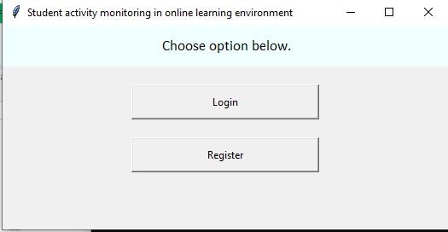
Login

Slide 18
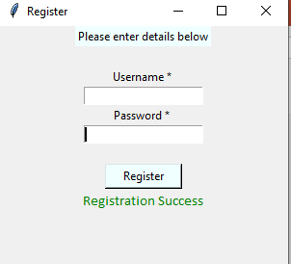
Signup

Slide 19
References
. McFarlin, Brian K. "Hybrid lecture-online format increases student grades in an undergraduate exercise physiology course at a large urban university." Advances in Physiology Education (2008).
. Higgins, Emily, Mallorie Leinenger, and Keith Rayner. "Eye movements when viewing advertisements." Frontiers in psychology 5 (2014): 210.
.Jensema, Carl J., Sameh El Sharkawy, Ramalinga Sarma Danturthi, Robert Burch, and David Hsu. "Eye movement patterns of captioned television viewers." American annals of the deaf 145, no. 3 (2000): 275-285.
. Leite, Bruno & Pereira, Eanes & Gomes, Herman & Veloso, Luciana & Santos, Cicero & Carvalho, Joao. (2007). A Learning-based Eye Detector Coupled with Eye Candidate Filtering and PCA Features. 187-194. 10.1109/SIBGRA.2007.4368184.

Slide 20


